Slide 1

Numerical Relay for Over current Protection
Muhammad Awais 506
Sara Babar Khan 539

Slide 2
Motivation
Numerical relays are the next generation relays which will soon replace the use of digital relays.
They have improved performance. So we have chosen this vary paper to represent future of Protective relaying
☺ ☺ ☺ ☺

Slide 3
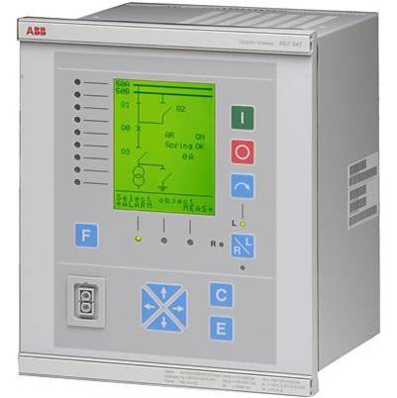
Abstract
Over-current protection is a very important element in power systems.
This protection is essential in order to minimize disturbances caused by
any failure in the system and to ensure continuous power delivery.
Over current relays are one of the devices used to achieve these purposes.
The over-current relays initiate the corrective mechanism to determine
the operation time of the relay. Thus, the over-current relays must have
high reliability and accuracy to detect any fault currents present and
determine the operation time. The entire system will tremendously affected
if the relays fail to trip or cause mal-tripping. An over-current relay
is implemented on a high speed and high performance
digital signal processor (DSP).
The simulation was carried out using MATLAB/Simulink. Then, the
relay was implemented on LM4F123GXL based on two different methods
Digital Relay
Numeric Relay

Slide 4
Computer Relays
Computer-based system with software-based protection algorithms for the detection of electrical faults.
Also called microprocessor type protective relays
Replacements for electro mechanical protective relays.

Slide 5
Numeric and Digital Relay
Difference
types of processor used
Numerical relay is embedded with digital signal processor (DSP)
Digital relay uses a microprocessor

Slide 6
Advantages and disadvantages
Digital Relay: limited processing capacity and memory in digital relay but less costly and less complex
Numeric Relay: The processing carried out using DSP is optimized for the real-time signal processing applications. Therefore numerical relays are faster.

Slide 7
Over Current Relay
When the current flowing into the overcurrent relay exceeds a set point amount, the relay operates with or without an intended time delay and trips the associated circuit breakers.

Slide 8
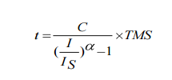
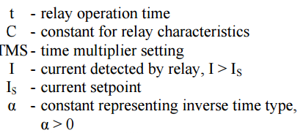
IDMT (inverse definite minimum time)
IDMT is the relay which starts to operate after the intended time delay. Greater the fault currents, the shorter are their operating time

Slide 9
Algorithm
Current is sampled
At least sampling rate >=2(Signal Frequency )
Nquist Criteria
RMS Value of I is Calculated
Then Operating time is calculated using algorithm.
If Irms>Iset Timers starts ticking
Circuit Breaker is tripped after time

Slide 10
Implementation
We have simulated it in three ways
Simulink
Numeric relay on Proteus
Demo Implementation on TM4C123GXL

Slide 11
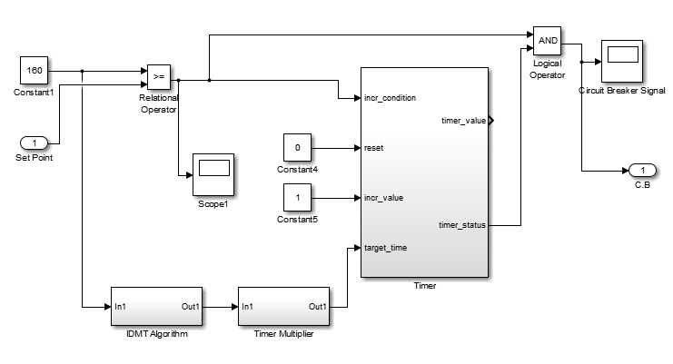
Simulink Simulation

Slide 12
Working
First of all value of current is compared against set point.
If Ifault>Iset, value for delay is calculated using algorithm and then given to counter
Counter starts counting up. And outputs 1 when time has reached.
If Ifault is still greater than Iset, trip the Circuit breaker.

Slide 13
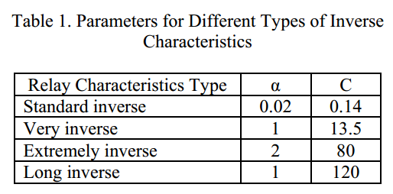
Variables for IDMT
We are using Very inverse Characteristics so
Alpha=1
C=13.5
And TMS is taken to be 0.1 as according to paper

Slide 14
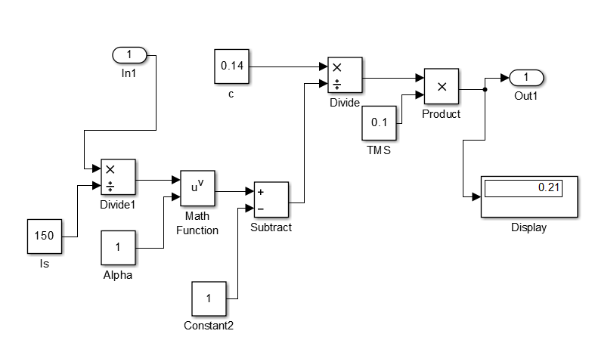

IDMT Algorithm in Simulink

Slide 15
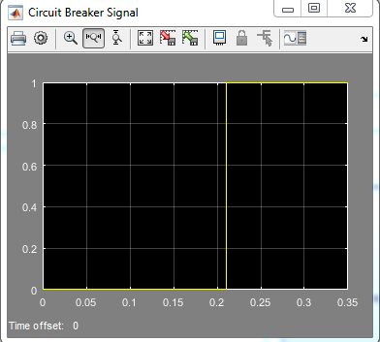
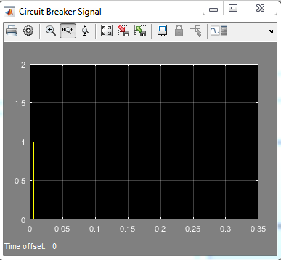
Results
For I=160 For I=500

Slide 16
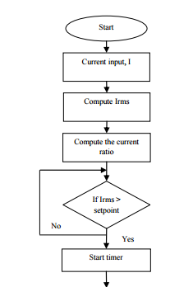
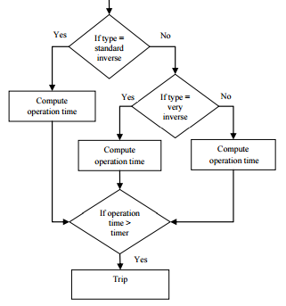
Hardware Implementation

Slide 17
TM4C123 Implementation
Four Devices of MCU was used
GPIO for Breaker signal
12 bit ADC of with 1k sampls/sec setting for proportional current sampling.
24 bit Systick Timer for idmt algorithm implementation
PLL to use MCU at 80MHz max speed

Slide 18
Flow Graph
CT 1000:1
Current Sensor
ADC of MCU
MCU
GPIO for breaker signal
SysTick Timer for dealy
Processing of t and logic

Slide 19
Digital And Numeric Relay Implementation
Implementation difference between numeric and digital relay is of sampling.
In Digital Relay, signal is first converted into DC and then sampled. So only one sample is enough.
While in Numeric relay, AC signal is sampled carefully

Slide 20
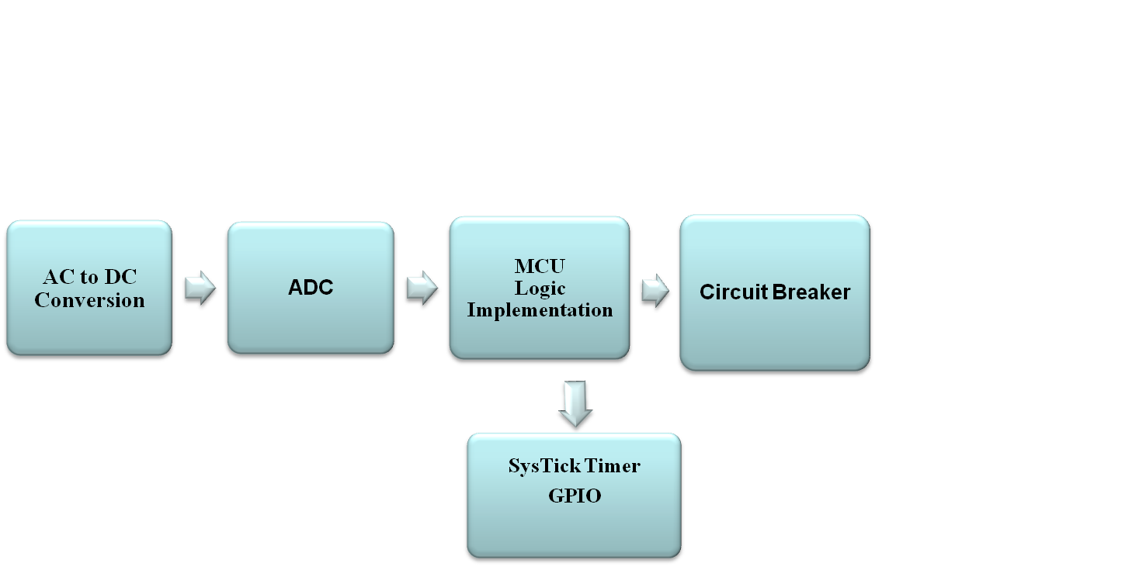
Digital Relay
AC to DC conversion
ADC sampling for MCU
MCU logic implementation
Circuit breaker signal

Slide 21

Numeric Relay
AC signal is sampled according to Nquist Criteria
Algorithm is applied for the calculation of RMS value
MCU logic implementation
Circuit breaker signal

Slide 22
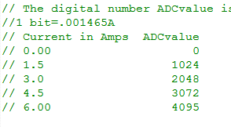
Simulation
Digital Representation
of current
Current is sampled 1kHz times each cycle according to Nquist theorem
for (i=0;i<1000;i++)
{
ADCvalue0 = ADC0_InSeq3();
ADCvalue=ADCvalue+ADCvalue0;
}

Slide 23
Simulation
Then RMS value is calculated
// RMS value Calculation
ADCvalue=ADCvalue/200;
rms=(ADCvalue*1000)/1414;
Then Time is calculated according to algorithm of paper
Logic for opening or closing of circuit breaker

Slide 24
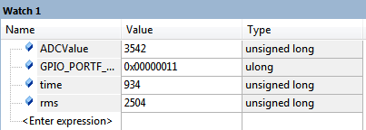
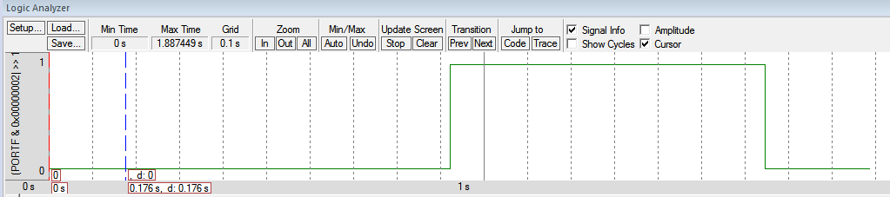
Results
For max current
Circuit Breaker Signal

Slide 25
Results
For max current
Circuit Breaker Signal

Slide 26
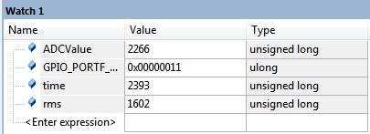
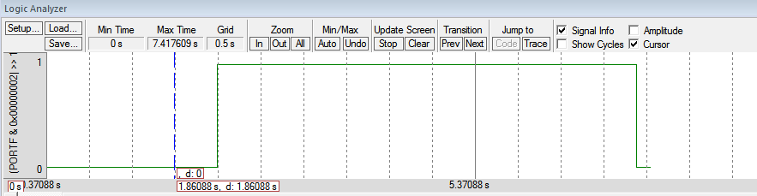
Results
For another smaller current
Circuit Breaker Signal

Slide 27
Problems
Time accuracy
Can be solved by using MCU of greater speed and DSP capabilities.
Algorithmic Problem
Doesn't check for current once enters the voltage loop

Slide 28
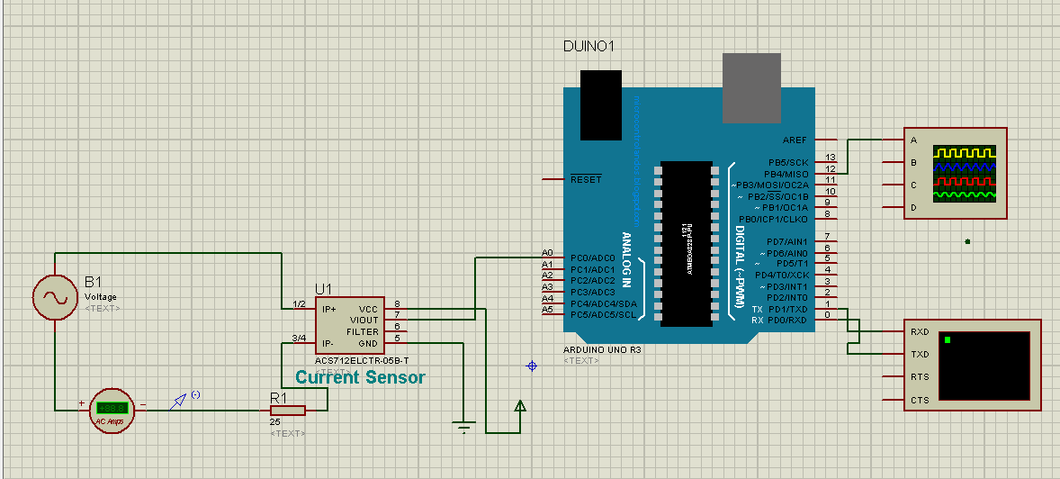
Implementation using Arduino
Same algorithm was implemented using arduino…

Slide 29
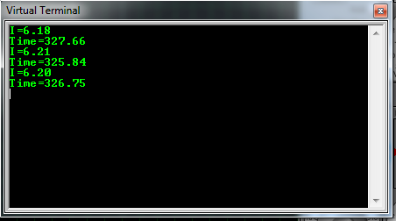
Result

Slide 30
Conclusion
Using Numeric relay, we can have more sophisticated general purpose, faster and cheaper relays. It is easy to upgrade them.
Time is most important factor and our specific relays MCU need to have more speed and also needed to be DSP. 80Mhz is not enough.

